Slide 1
Connectionist Computing
COMP 30230/41390
Gianluca Pollastri
office: CASL, ground floor Science East.
email: gianluca.pollastri@ucd.ie
Connectionist Computing COMP 30230

Slide 2
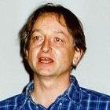


Credits
Geoffrey Hinton, University of Toronto.
  borrowed some of his slides for “Neural Networks” and “Computation in Neural Networks” courses.
Ronan Reilly, NUI Maynooth.
  slides from his CS4018.
Paolo Frasconi, University of Florence.
  slides from tutorial on Machine Learning for structured domains.
Connectionist Computing COMP 30230

Slide 3
Lecture notes on Moodle
https://csmoodle.ucd.ie/moodle/course/view.php?id=288
Strictly confidential...
Enrolment key: 30230cc
Connectionist Computing COMP 30230

Slide 4
Books
No book covers large fractions of this course.
Parts of chapters 4, 6, (7), 13 of Tom Mitchell’s “Machine Learning”
Parts of chapter V of Mackay’s “Information Theory, Inference, and Learning Algorithms”, available online at:
http://www.inference.phy.cam.ac.uk/mackay/itprnn/book.html
Chapter 20 of Russell and Norvig’s “Artificial Intelligence: A Modern Approach”, also available at:
http://aima.cs.berkeley.edu/newchap20.pdf
More materials later..
Connectionist Computing COMP 30230

Slide 5
Marking
3 landmark papers to read, and submit a 10-line summary on Moodle about: each worth 6.67%
a small connectionist tool to build and play with: 30%
Final exam: 50%
Connectionist Computing COMP 30230

Slide 6
Programming assignment
Implement a Multi-Layer Perceptron, test it.
The description on Moodle.
Submit through Moodle code and test results by April the 28th at 23:59, any time zone of your choice (Baker Island?).
30% of the overall mark
One third of a grade down every day late, that is: if you deserve an A and you’re 1 day late you get an A-, 2 days late a B+, etc.
Connectionist Computing COMP 30230

Slide 7
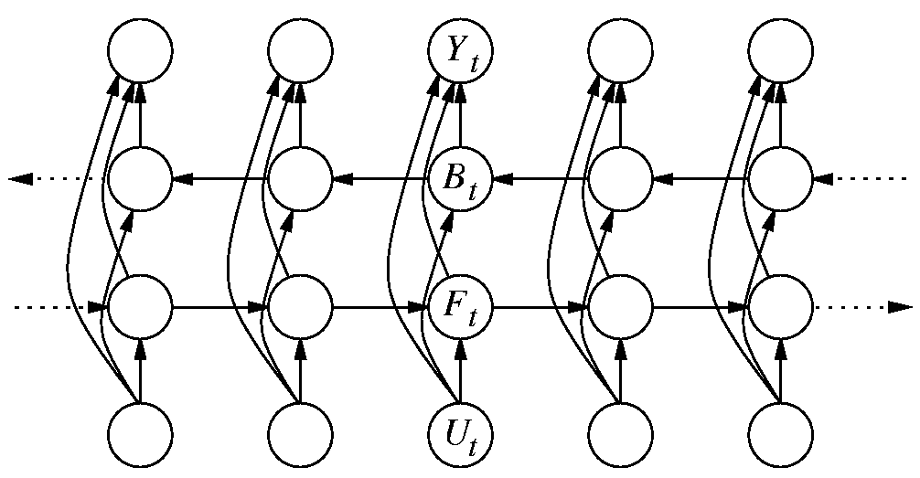
Bidirectional Recurrent Neural Networks (BRNN)

Slide 8
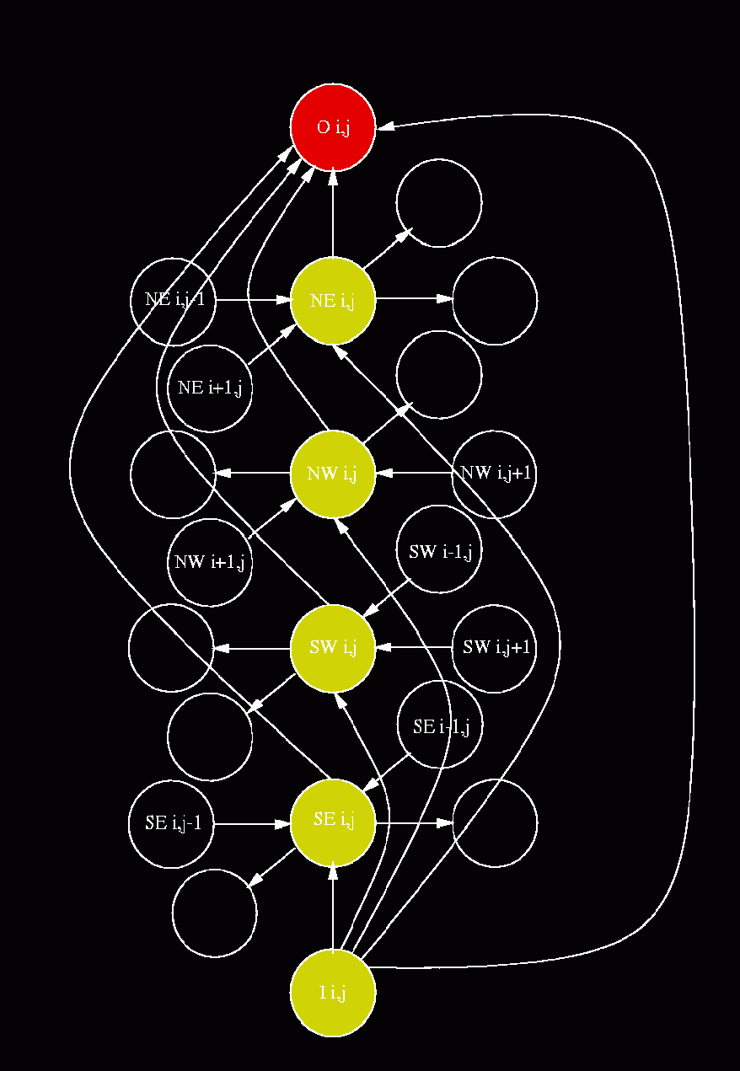
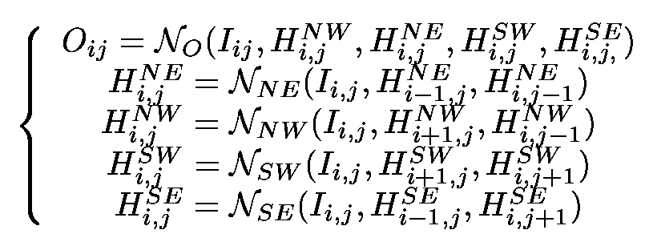
2D RNNs
Pollastri & Baldi 2002, Bioinformatics
Baldi & Pollastri 2003, JMLR

Slide 9
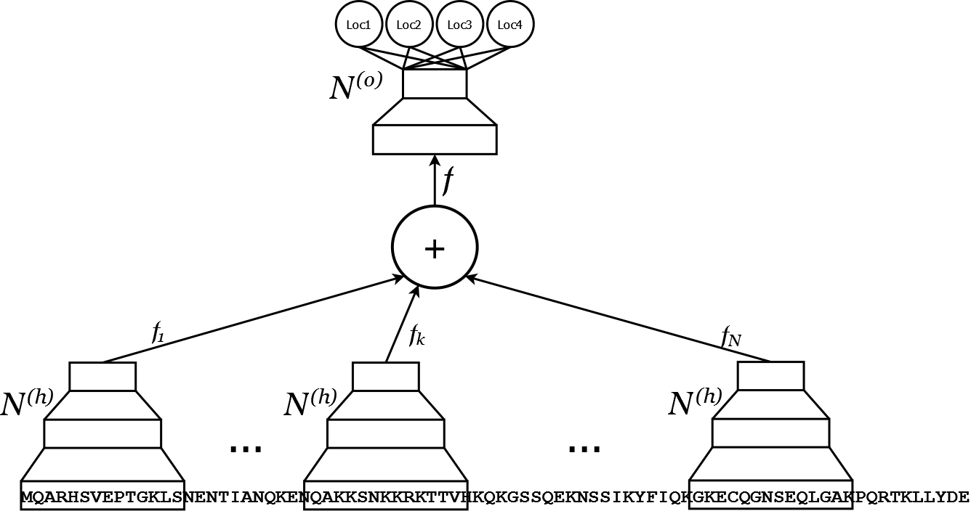
N to 1 Neural Networks
Mooney, Wang & Pollastri, Bioinformatics, 2011

Slide 10
f
Vector f is a property-driven, adaptive compression of the whole sequence: fixed size!
What does it tell us about whatever sequences we are dealing with?
Can we explore/map the space of sequences by looking at their f?

Slide 11
N-to-1 NN results
Best systems in the world for protein subcellular localisation prediction.
Spare capacity. As sets grow bigger, it may do better and better.

Slide 12
Full, general graphs
Can we extend this process to any shape and map?
Yes we can, but let me tell you how through a story.
Connectionist Computing COMP 30230

Slide 13
Small molecules
Small organic compounds that are bioactive, but are not proteins, DNA, RNA, etc.

Slide 14
QSAR
Quantitative Structure-Activity Relationship
Based on the observation that what a molecule does depends on its (chemical? 3D?) structure
Computationally, predict Activity or Properties of small molecules, e.g. toxicity, carcinogenicity, biodegradability, anti-cancer activity, etc.

Slide 15
Why QSAR?
Screening computationally is a lot cheaper than screening experimentally.
You have 10,000 compounds that may (or may not) do a job. If you can prune 9,950 of them by computational means you have saved a lot of time and $$$.
(Designing 1 drug costs ~2bln and takes 13.5 years on average..)

Slide 16


Traditional QSAR framework
t() encodes a structure (graph, or 3D, or both) into a fixed-width array of descriptors of a molecule.
g() maps this array into the property of interest.
Finding t() is the real challenge. Once there is a good t(), the problem is solved.

Slide 17
Finding t()
For many domains you can ask experts to tell you what makes a good carcinogen/ toxic molecule/ biodegradable molecule etc.

Slide 18
Finding t(): asking experts
But that's work..
And then you have to endure meeting them over a Scotch at 11am.
Besides, the expert will be inherently fallible, and dated.

Slide 19
Finding t() (2)
You can toss every t() you have in your arsenal at it and pick the best (trial and error).
But that's cheating, really, unless you have 1G molecules to prevent you from fooling yourself into thinking your tail is your average.
And we ain't got 1G molecules (though I've been told we apparently do).

Slide 20
Methods for QSAR (on ~1 slide)
Linear regression (on what features?)
ANN (same?)
Recursive NN (but need a DAG!)

Slide 21
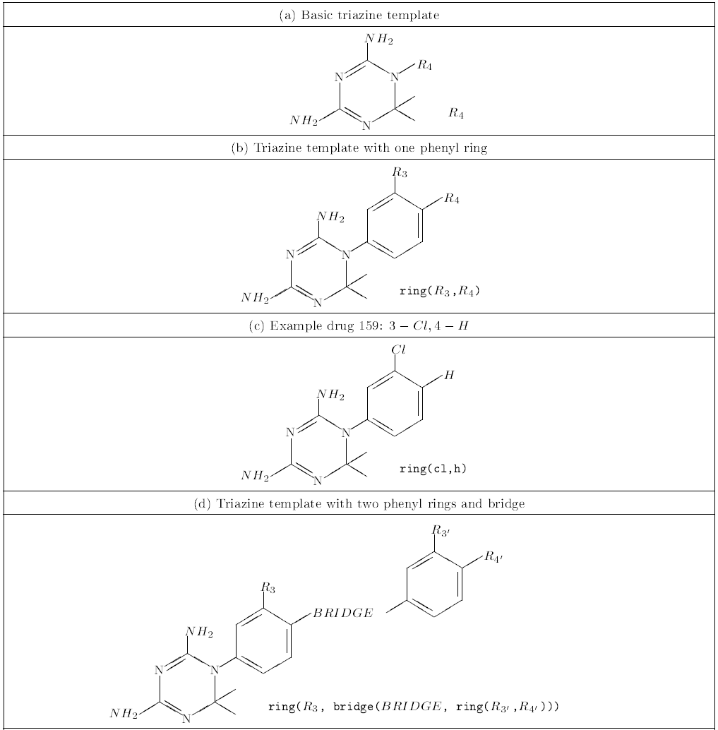
Schmitt & Goller 1998

Slide 22
A lazy computer scientist's viewpoint
Molecules are Undirected Graphs
In principle, the property of interest may be determined by any part of the graph
Context matters, a lot
No direction is, in principle, more important
We are too lazy to learn about molecules

Slide 23
Besides, variable
Molecular graphs are of variable size.
We have to come up with models that deal with that, or still endure those 11am Scotches.

Slide 24
A lazy computer scientist's viewpoint (2)
Molecules are Undirected Graphs
In principle, the property of interest may be determined by any part of the graph
Context matters, a lot
No direction is, in principle, more important
We are too lazy to learn about molecules
Factorise a UG into as many DAGs as it takes so that each node becomes a root
If N nodes, this obviously makes N DAGs (but small molecules are small!)

Slide 25
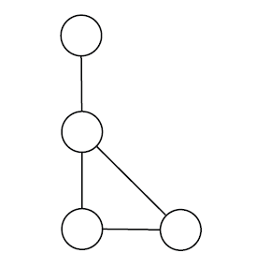
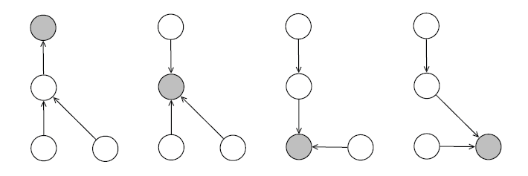
Example

Slide 26
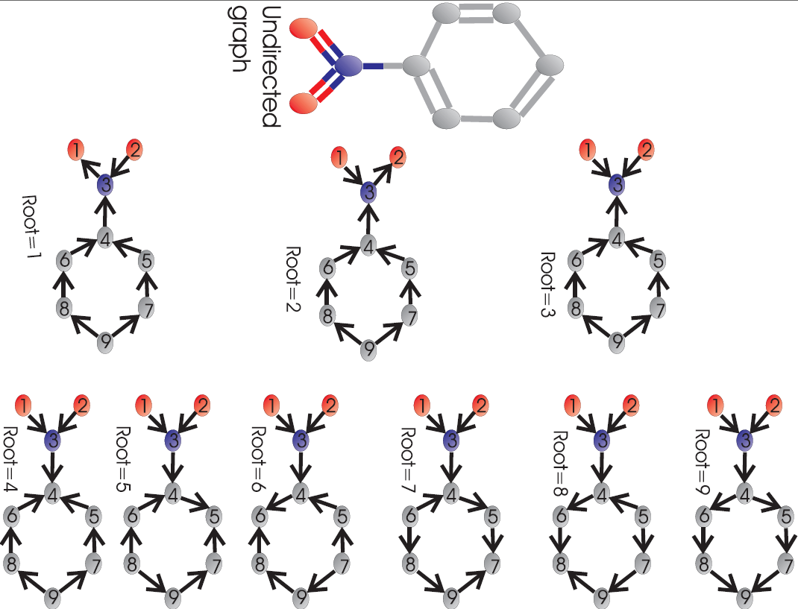

Slide 27

What we have done (3)
The state of each vertex in the k-th DAG is a function of the atom (and potentially anything else we know) at that vertex, and the states of the children:
When there are no children, the recursion ends.

Slide 28
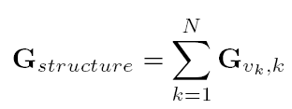
What we have done (4)
Problem: there are N graphs, hence N roots, hence N vectors G (contexts around each atom). How to map them to 1 property? Add them up! If v_{k} is the root vertex in the k-th graph:
All graphs compete to be in this global state: it is an adaptive form of compression, property driven!

Slide 29

What we have done (5)
We map the global state into the property of interest (o) as:
The molecule-to-features and features-to-output functions are modelled by Multi-Layer Perceptrons.
We train the whole thing (all DAG’s and all) by gradient descent.

Slide 30
In plain language..
We look at the graph from the point of view of each node.
We add up all these points of view.
What we get is a fixed-width vector of real numbers that describes the graph.
Based on this vector we predict the property.
Note: what vector we get depends on the property we’re trying to predict.

Slide 31
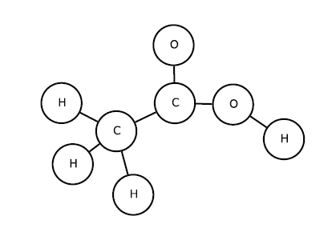
Overall example
UG of acetic acid

Slide 32
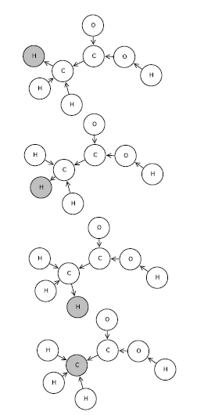
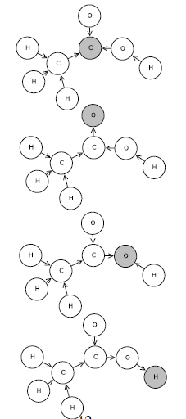
Factorising..

Slide 33
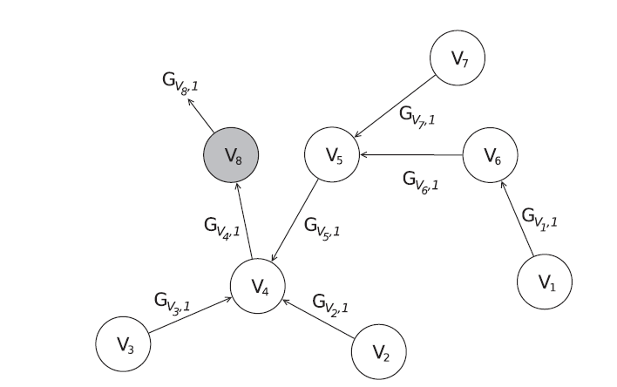
One graph

Slide 34
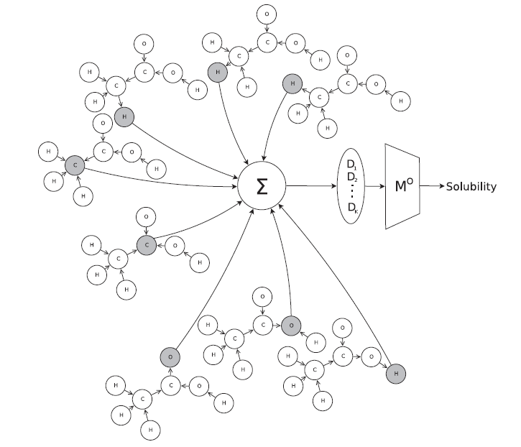
A.Lusci, G.Pollastri, P.Baldi,
"Deep architectures and deep learning in chemoinformatics:
the prediction of aqueous solubility for drug-like molecules",
Journal of Chemical Information and Modeling, 2013

Slide 35
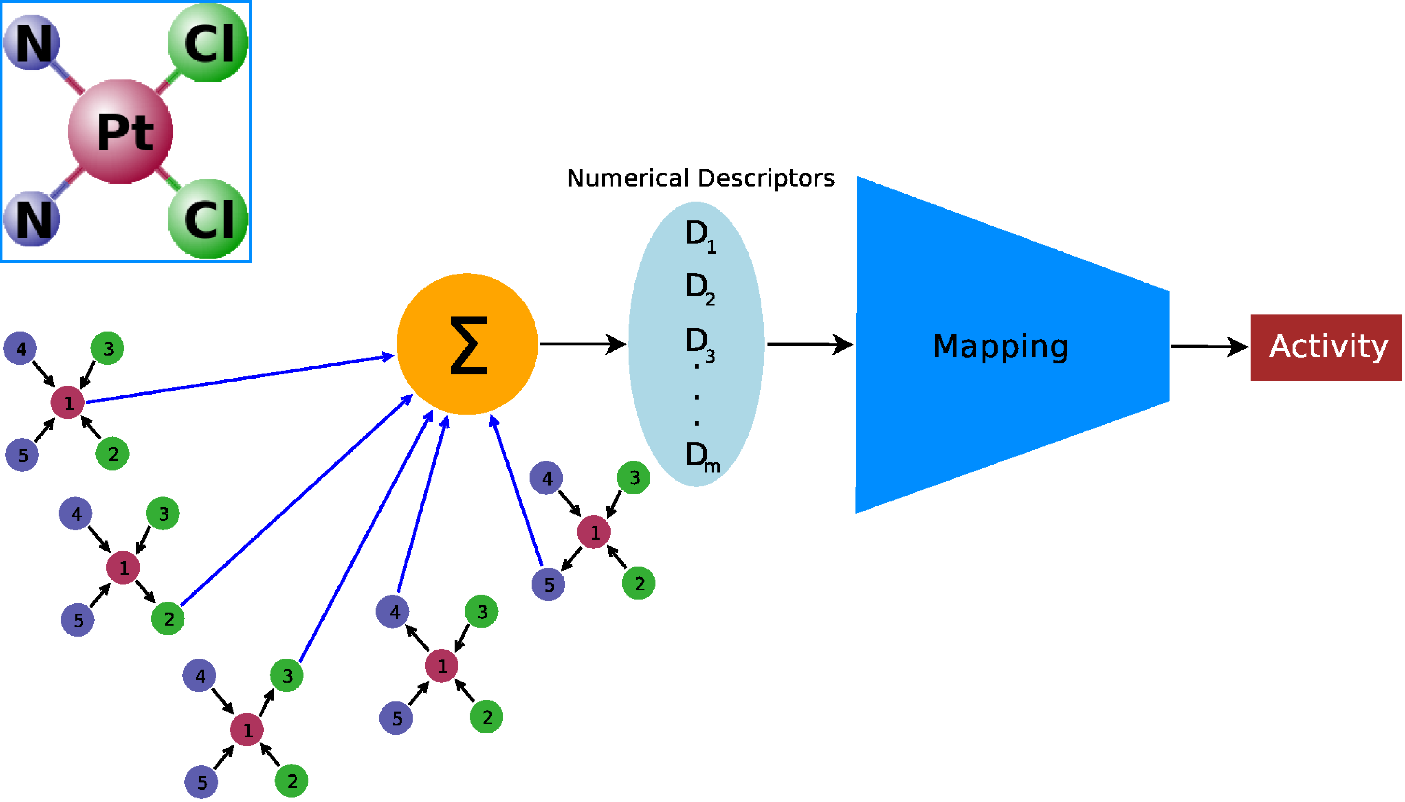

Slide 36
Training
Model is a feed-forward neural net: backpropagation.
But it's deep (paths of variable depth) and the gradient vanishes, even when the graphs are small.
Clip the gradient on both sides.. If it's smaller than X, make it X. If it's bigger than Y, make it Y.
Massive speedup in training times.

Slide 37
UG-RNN
Do they work?
Yes they do, better than anything else.
And they automatically find the features.
They are DEEP, of course, so they are clever.
But they are hard to train.
Connectionist Computing COMP 30230

Slide 38
Summary: NN for structured data
No need to design features. This is good:
  no extra work, experts, morning imbibing, etc.
  and, more importantly, less risk of overfitting the test set by trying 1000 different combinations of hyperparameters
Some of these models are a bit temperamental and need special (deep) learning techniques to work
Connectionist Computing COMP 30230

